Slide 1
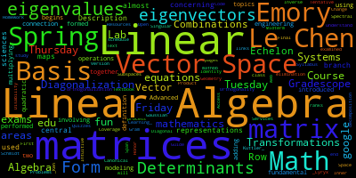
Linear
Algebra

Slide 2
Lecture Contents
Definition and Introduction
Applications
Linear Equation and system of Linear Equations
Topics in Linear Algebra
Solution Types

Slide 3
Scenario: The 3D Game Developer’s Challenge
Imagine you’ve just landed your dream job at a top gaming company like Ubisoft or Rockstar Games. Your first task? To develop a new 3D adventure game where players explore a futuristic city. But there’s a problem...your objects aren’t moving, rotating, or scaling correctly! Buildings are floating, cars are upside down, and the game world is a mess!

Slide 4
Scenario: The 3D Game Developer’s Challenge
Your Mission:
How can you rotate a game character correctly in 3D space? 🔄
How do you scale objects to make them look realistic? 📏
How can you apply shadows, lighting, and physics? ☀️
"The secret behind all of this? Linear Algebra! It’s the math that makes every modern game look smooth, realistic, and immersive."

Slide 5
Reveal the Truth:
These transformations are done using matrices
Moving characters? Vector operations ➡️
Rotating a player’s view? Rotation matrices 🔄
Scaling objects? Scaling matrices 🔍
"Linear Algebra isn’t just numbers—it’s what makes the digital world move! Master it, and you can build the next-gen AI, animations, and immersive tech!"

Slide 6
Linear Algebra: Definition
"Linear" → Because it deals with straight-line relationships (like scaling, adding, and transforming data in a predictable way).
🔹"Algebra" → Because it involves solving equations, manipulating symbols, and performing operations on numbers, vectors, and matrices.
In short: Linear Algebra studies how data and geometric objects change in a structured, straight-line manner, which is essential in fields like AI, graphics, and data science.

Slide 7
Definition and Applications
Linear Algebra is the mathematics of data, dealing with numbers, shapes, and patterns organized in grids (matrices) and lists (vectors).
It helps in solving equations, transforming images, analyzing relationships in data, and optimizing algorithms.

Slide 8
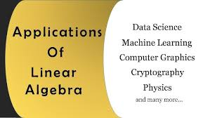

Slide 9
Transformation Matrix

Slide 10
How a Matrix is Built & Its Real-World Implementation
Imagine you're developing a
Netflix-like movie recommendation system.
You need to store user ratings for different movies.
You start with a table of ratings where:
Rows = Users (U1, U2, U3, ...)
Columns = Movies (M1, M2, M3, ...)
Entries = Ratings (1-5 stars)

Slide 11
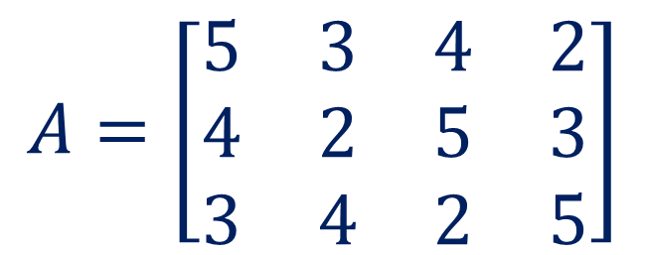
How a Matrix is Built & Its Real-World Implementation
 | M1 | M2 | M3 | M4
U1 | 5 | 3 | 4 | 2
U2 | 4 | 2 | 5 | 3
U3 | 3 | 4 | 2 | 5
This table is actually a matrix!
$$A=\left[\begin{matrix}5 & 3 & 4 & 2 \\ 4 & 2 & 5 & 3 \\ 3 & 4 & 2 & 5\end{matrix}\right]$$
Now, we can use this matrix to find similar users and recommend movies using Linear Algebra.

Slide 12
How a Matrix is Built & Its Real-World Implementation
Finding Similar Users or Movies (Collaborative Filtering)
Goal: Find users or movies that are similar based on their rating patterns.
User-Based Filtering:
Find users with similar tastes (e.g., if U1 and U2 gave similar ratings, they are similar).
If U1 liked M3, and U2 hasn’t watched it yet, recommend M3 to U2.
Movie-Based Filtering:
If two movies (M1 and M3) get similar ratings from many users, they are similar.
If U1 watched M1 and hasn’t seen M3, suggest M3 to U1.

Slide 13
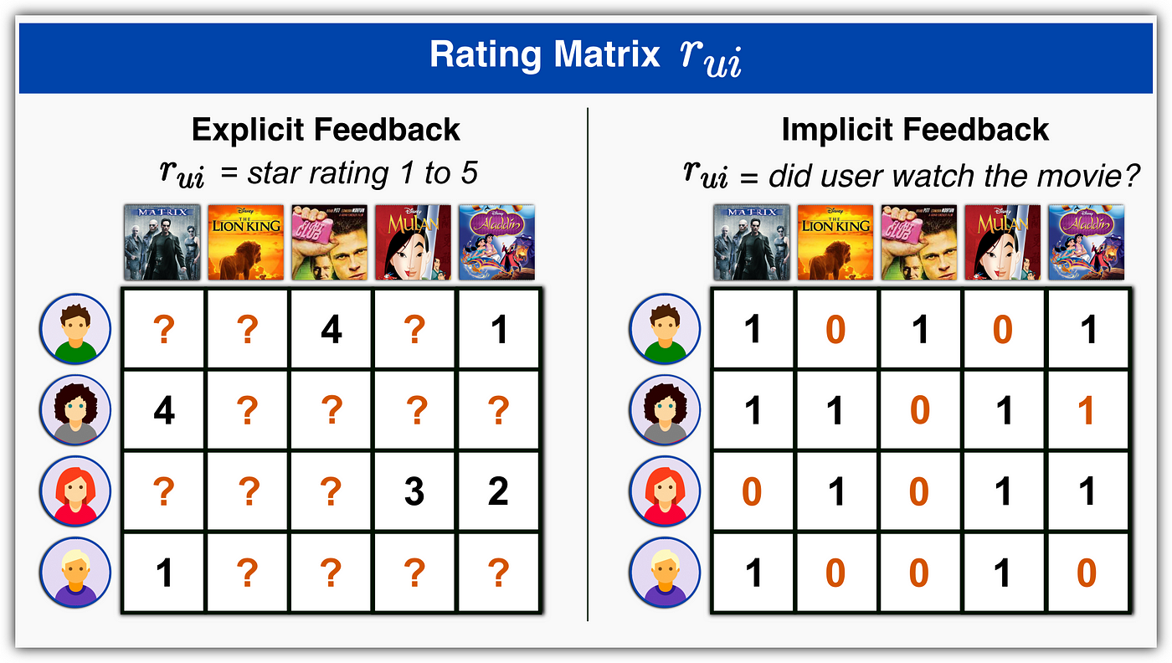

Slide 14
Summary: How Netflix Uses Linear Algebra
1️⃣ Matrix Representation: Store user-movie ratings as a matrix. 2️⃣ Similarity Computation: Find similar users or movies (collaborative filtering). 3️⃣ Matrix Factorization (SVD): Predict missing ratings. 4️⃣ Deep Learning (Autoencoders): Learn complex user preferences. 5️⃣ Continuous Learning: Improve recommendations over time.

Slide 15
How Linear Algebra Helps in AI, Graphics, and Data Science
Situation: You Are Developing a Self-Driving Car System 🚗
Imagine you're working on AI for a self-driving car, and it needs to: 1️⃣ Detect objects on the road (pedestrians, vehicles, signs). 2️⃣ Process sensor data from cameras and LiDAR (Light Detection and Ranging). 3️⃣ Navigate safely by predicting movement.

Slide 16
How Does Linear Algebra Work Here?
🔹 1. Image as a Matrix (Graphics & AI)
A grayscale image is just a matrix of pixel values.
Image transformations (blurring, edge detection) use matrix operations.
🔹 2. Object Detection Using Vectors (AI & Deep Learning)
Every detected object is represented as a vector.
AI models classify objects by analyzing these vectors.
🔹 3. Predicting Car Movements (Data Science & Machine Learning)
Car positions over time are stored as matrices.
Linear regression (a linear algebra technique) predicts future positions.

Slide 17
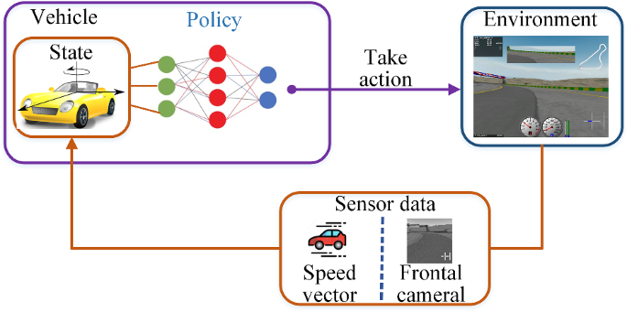
Self-Driving Car System 🚗

Slide 18
Some Topics of Linear Algebra
System of Linear Equations
Matrices
Gaussian Elimination and Gaussian Jordan Method
Vector Spaces
Matrix Transformation
Cryptography
Eigen Values and Eigen Vectors and its applications to Machine Learning.

Slide 19
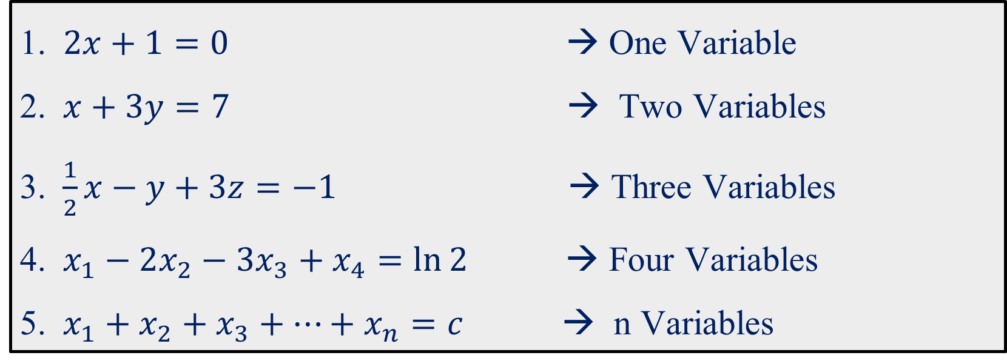
Linear Equation
An equation whose exponent or power is one is called linear equation.
$2x+1=0$ → One Variable
$x+3y=7$ → Two Variables
$\frac{1}{2}x−y+3z=−1$ → Three Variables
$x_{1}−2x_{2}−3x_{3}+x_{4}=\ln{2}$ → Four Variables
$x_{1}+x_{2}+x_{3}+…+x_{n}=c$ → n Variables
Linear equation does not involve any products or roots of variables.
All variables occur only to the first power and do not Appear as
arguments of trigonometric, logarithmic, or exponential functions.

Slide 20





Question: The following equations are linear or nonlinear? If it is nonlinear which term in each equation is making it nonlinear?
No
No
$$x+3y^{2}+2z=4$$
$$3x+3y−xy=5$$
No
No
$$sin(x)+2y=0$$
$$\sqrt{x_{1}}+x_{2}+x_{3}=1$$
$$3x+2y=\cos{20}$$

Slide 21
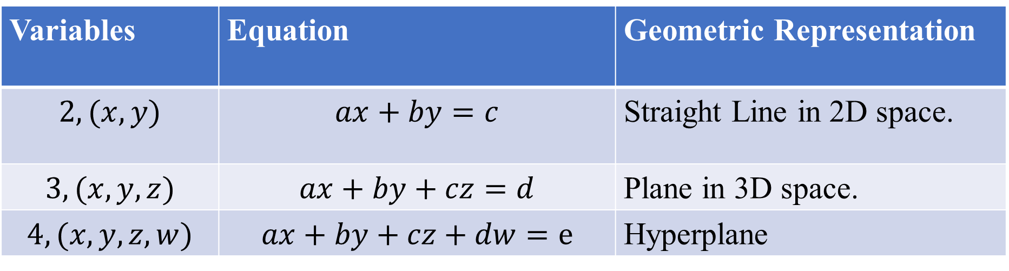
Geometric Representation of Linear Equations
Variables | Equation | Geometric Representation
$$2, (x,y)$$ | $$ax+by=c$$ | Straight Line in 2D space.
$$3,(x,y,z)$$ | $$ax+by+cz=d$$ | Plane in 3D space.
$$4,(x,y,z,w)$$ | $$ax+by+cz+dw=e$$ | Hyperplane
Linear Equations with More Than Three Variables $(x_{1},x_{2},x_{3},…)$
In 4D space and beyond, each linear equation represents a hyperplane (a higher-dimensional version of a plane that we cannot visualize directly).
Hyperplanes are widely used in machine learning (SVMs), optimization, and data classification.

Slide 22
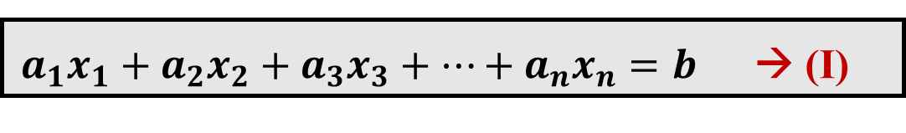
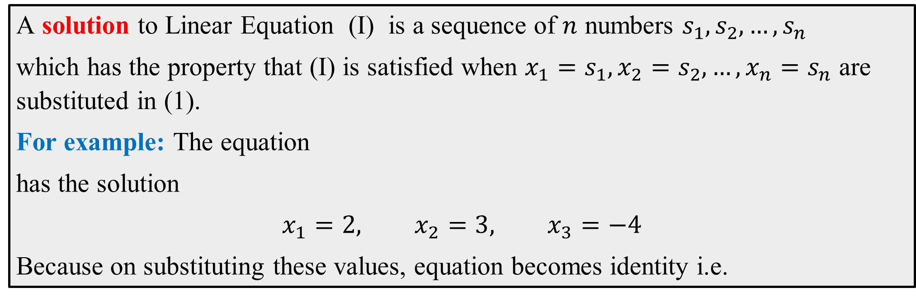


Solution of a Linear Equation
$a_{1}x_{1}+a_{2}x_{2}+{a_{3}x}_{3}+…+{a_{n}x}_{n}=b$ → (I)
A solution to Linear Equation (I) is a sequence of $n$ numbers $s_{1}, s_{2},…, s_{n}$
which has the property that (I) is satisfied when ${x_{1}=s}_{1},x_{2}=s_{2},…, {x_{n}=s}_{n}$ are substituted in (1).
For example: The equation
has the solution
$$x_{1}=2, x_{2}=3, x_{3}=−4$$
Because on substituting these values, equation becomes identity i.e.
$$6x_{1}−3x_{2}+4x_{3}=−13$$
$$6(2)−3(3) +4(−4)=−13$$
$$−13 = −13$$

Slide 23





System of a Linear Equations
A finite set of linear equations is called a system of linear equations or, more briefly, a linear system. The variables are called unknowns.
$$x+2y=10$$
Linear System in two unknown
$$2x+3y=20$$
$$x+y+2z=9$$
Linear System in three unknown
$$2x+4y−3z=1$$
$$3x+6y−5z=0$$

Slide 24





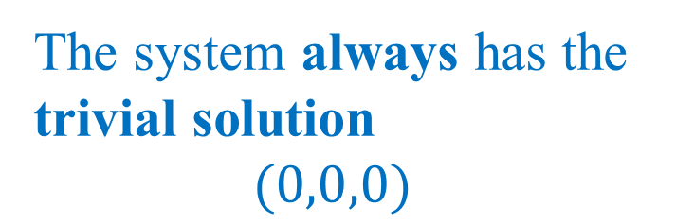

Homogeneous Linear System
Non-Homogeneous Linear System
A homogeneous system has all constant terms equal to zero
A non-homogeneous system has at least one nonzero constant on the right-hand side
$$3x+2y+2z=0$$
$$2x+3y−z=5$$
$$2x+4y−3z=0$$
$$x−4y+3z=6$$
$$3x+6y−5z=0$$
$$3x−y+2z=8$$
The system always has the trivial solution
$$(0,0,0)$$

Slide 25
Consistent and Inconsistent Linear System
If the linear system has no solution, it is said to be inconsistent, if it has a solution. it is called consistent.
A consistent linear system of two equations in two unknowns has either one solution or infinitely many solutions--there are no other possibilities.

Slide 26

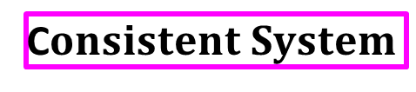








Linear System with Two Variables
$$x+2y=10$$
$$x+2y=10$$
$$x+2y=10$$
$$2x+4y=20$$
$$2x+4y=18$$
$$2x+3y=20$$
One Solution
Infinitely many solutions
No Solution
(Intersecting lines)
(Coincident lines)
(Parallel lines)
$$0=0$$
$$0=constant$$
$$Inconsistent System$$
C$onsistent System$

Slide 27
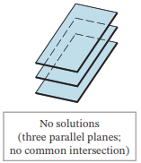
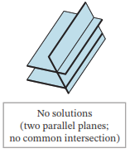
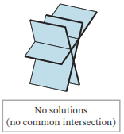
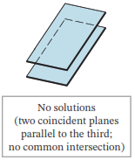












Linear System (inconsistent) in three variables
$$2x−3y+4z=10$$
$$2x−3y+4z=10$$
$$x+y+z=1$$
$$2x−3y+4z=5$$
$$2x−3y+4z=5$$
$$2x−3y+4z=5$$
$$2x−y+3z=5$$
$$4x−6y+8z=10$$
$$2x−3y+4z=8$$
$$2x−5y+2z=11$$
$$3x+4y−z=0$$
$$2x−3y+4z=7$$

Slide 28
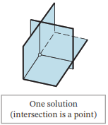
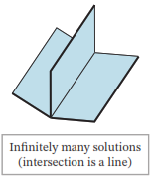
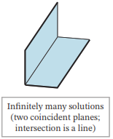
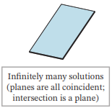











Linear System (consistent) in three variables
$$x+y+z=6$$
$$x+y+z=3$$
$$x+y+z=1$$
$$x+y+z=1$$
$$2x−y+3z=14$$
$$2 x−y+z=4$$
$$2x+2y+2z=2$$
$$2x+2y+2z=2$$
$$3x+4y−2z=4$$
$$3x+0y+2z=7$$
$$3x+4y+3z=3$$
$$x−y+z=3$$

